Slide 1
Interaction Types

Slide 2
What is an interaction type?
An interaction type is a way to interact between a user and app/system.

Slide 3
4
Instructing
Conversing
Types of
Interaction
Manipulating
Exploring

Slide 4

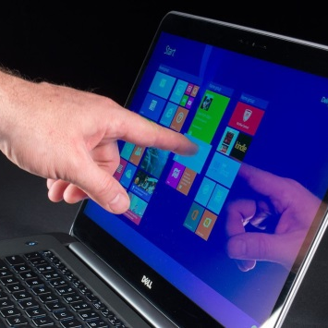

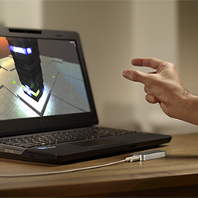

Instructing:
Where users issue instructions to a system
Typing commands
Selecting menu
/ touching icons
Speaking aloud commands
Gesturing
Pressing buttons

Slide 5
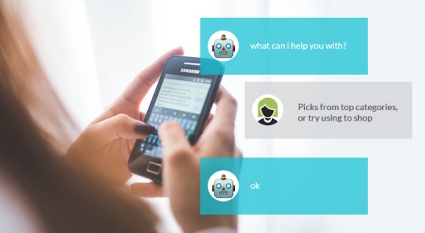

Conversing:
Where users have a dialog with a system
Typing questions and replying via text
Speaking and replying via speech output

Slide 6
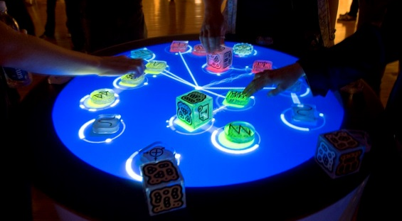
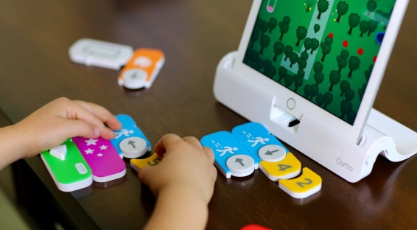
Manipulating:
Where users interact with objects in a virtual or physical space by manipulating them
Placing, holding, rotating, etc.
Neighboring

Slide 7


Exploring:
Where users move through a virtual environment or a physical space
Virtual reality
Mixed (Augmented) reality

Slide 8
Interaction Types
Question 1.
The “exploring” interaction type is associated with ____?
New user interfaces
Menu based operating systems
Mixed and virtual reality
Google maps

Slide 9
Interaction Types
Question 2.
The interaction type “manipulating” is associated with ______ ?
Touching an icon
Pressing a button
Playing Pokemon Go
Tangible digital objects

Slide 10
Interaction Types
Question 3.
All user interface types are a kind of instructing.
True
False

Slide 11
Interaction Types
Question 4.
Chatbots are a kind of conversing interface type.
True
False

